Slide 1
Detecting the source of spread in complex networks
Part II
Boleslaw Szymanski and Krzysztof Suchecki
RPI, Troy

Slide 2
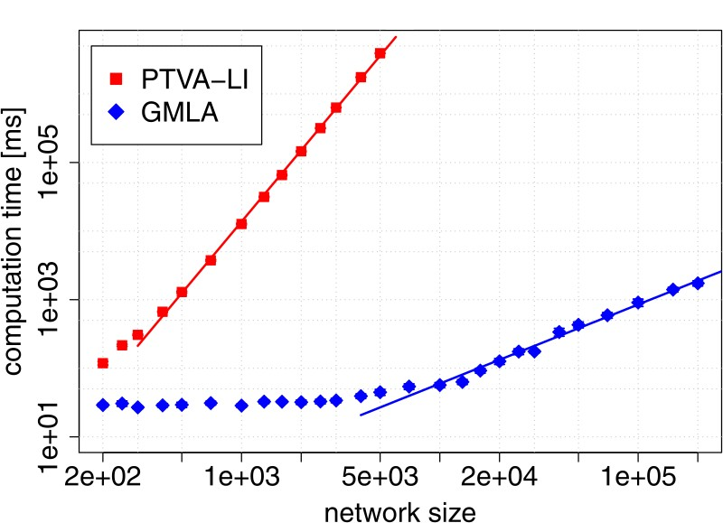
Beyond basic methods
●
Make it faster (because it's slow O(N³) or worse)
In particular O(N·(N²+K³)), where N is network size and K is number of observers. If K~N, then it is as bad as O(N⁴) !
possible to make it
~10000 times faster for networks of ~1000 nodes
Feasible to calculate for networks of even millions of nodes (will not take 1000 years)
Cause:
- calculating likelihood score for each node
using potentially large number of observers, requiring large tree and matrix operations
Solution:
use greedy gradient (limits node to calculate score for)
use only closest (smallest arrival time) observers to calculate likelihood

Slide 3
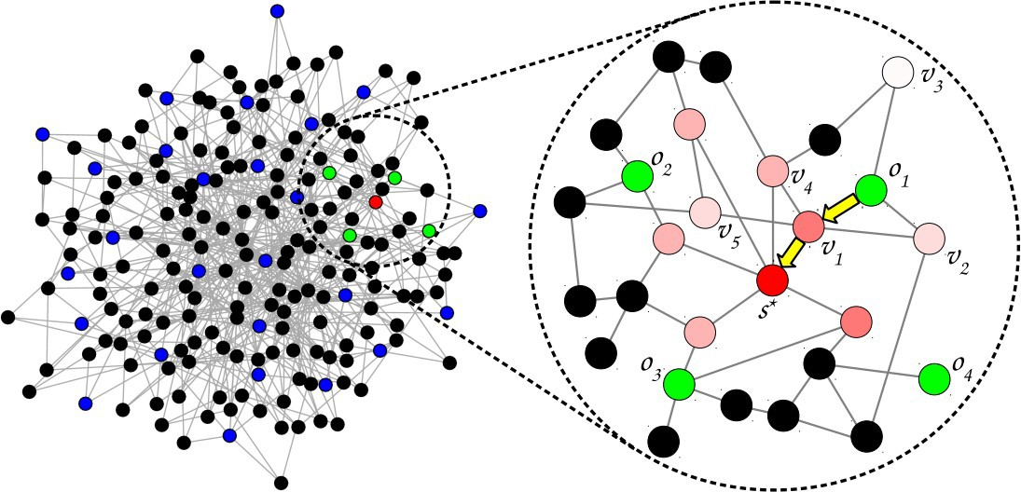
Beyond basic methods
●
Make it faster (because it's slow O(N³) or worse)
Only some observers taken into account (green)
Solution:
use greedy gradient (limits node to calculate score for)
use only closest (smallest
arrival time) observers to calculate likelihood
Note: accuracy does not decrease in most situations, sometimes even increases !
Not all nodes have score calculated (only pink/red)
Gradient Maximum Likelihood algorithm
R. Paluch, X. Lu, K. Suchecki, B.K. Szymański, J.A. Hołyst, “Fast and accurate detection of spread source in large complex networks”, Scientific Reports 8, 2508 (2018), doi: 10.1038/s41598-018-20546-3

Slide 4
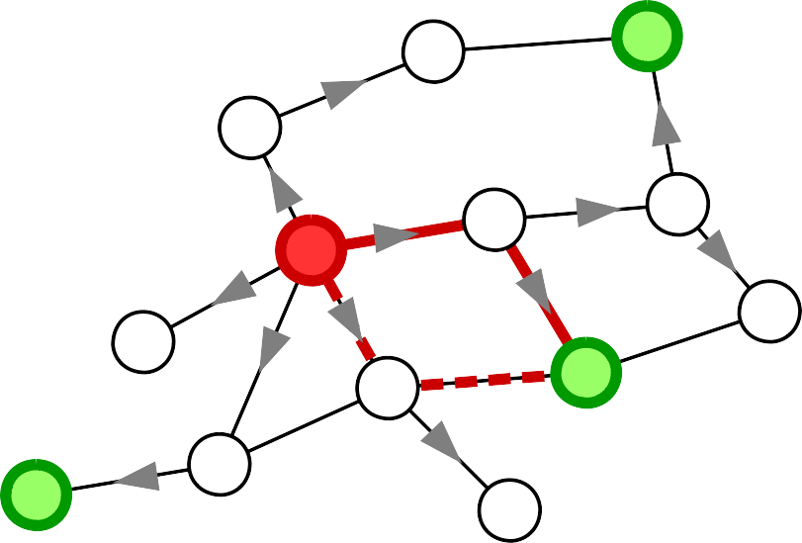
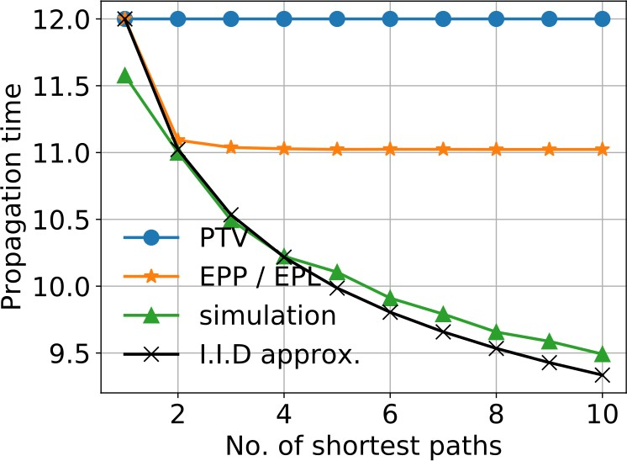
Beyond basic methods
o
Don't approximate with a tree
2
●
Multiple paths change mean time, even if they have same length
A
s
B
C
D o
1
o
3
t =min(A+B, C+D)
2
⟨t ⟩=⟨min(A+B, C+D)⟩≠min(⟨A+B⟩, ⟨C+D⟩)=2μ
2
Multiple paths can be taken into account when calculating expected mean times μ. Issue: correlations between them (which change mean of minimum)
Mean of the minimum of two IID random variables is smaller than mean of that variable.

Slide 5
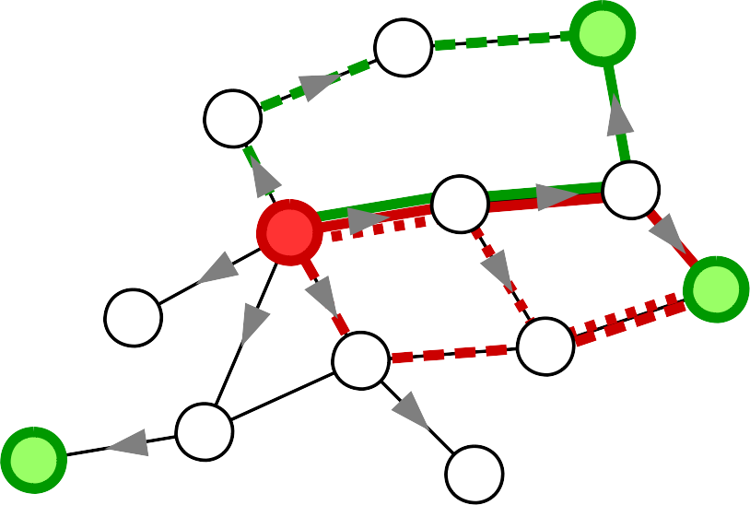
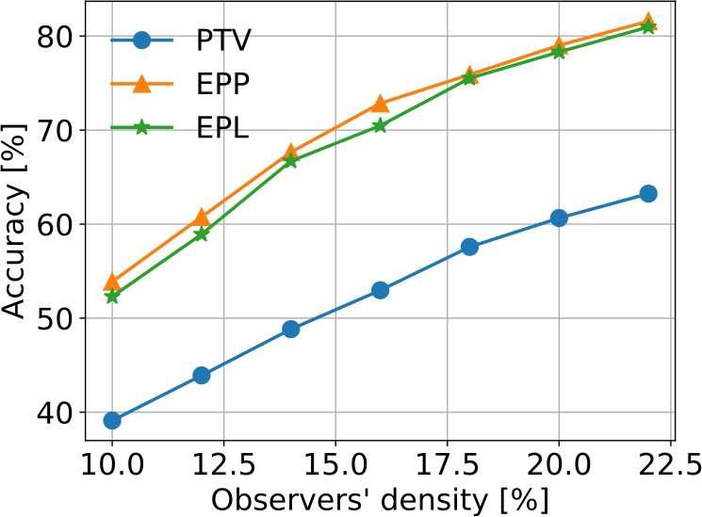
Beyond basic methods
o
Don't approximate with a tree
2
●
No exact analytical solutions – only approximations possible.
s
Mean:
> Exact value for least correlated single pair.
> As if paths are uncorrelated
o
1
Covariance:
> Equiprobable Paths (EPP) – assume it's equal to mean of covariances of all path pairs in the two sets.
> Equiprobable Links (EPL) – assume
it's equal to overlap between sets of links of both path sets.
o
3
Ł.G. Gajewski, K. Suchecki, J.A. Hołyst, Multiple propagation paths enhance locating the source of diffusion in complex networks, Physica A 519, 34-41 (2019),
doi: 10.1016/j.physa.2018.12.012

Slide 6
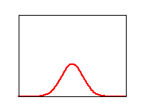
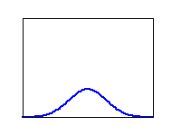
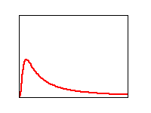
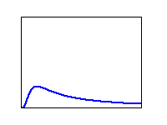
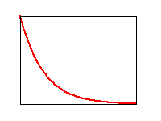
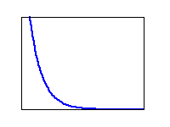
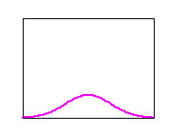
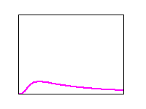
Beyond basic methods
●
Use other distribution than normal
Idea is obvious, but solution is hard:
●
If sum of 2 variables is from different distribution than each, number of variables can affect the shape of distribution, not only parameters
assuming stable distribution (sum comes form same distribution) mean of sum will be sum of means, but how do other parameters of distribution change ?
Extra issue: analytical stable distributions have infinite (Levy) or undefined
(Cauchy) mean !
Normal Stable Other
●
+
+ +
?
???

Slide 7
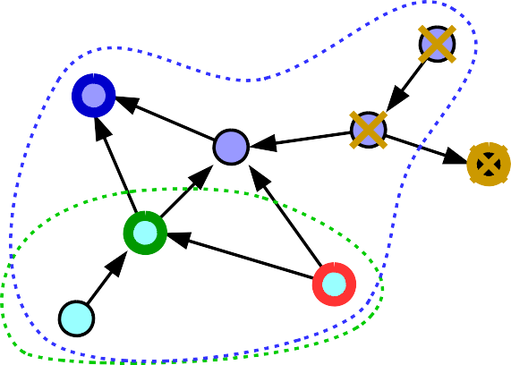
Beyond basic method
●
Adapt for directed, weighted network
If the probability of infection depends on the link ? → weighed networks
o
0
If the link is one-sided (e.g. only reader of infecfed e-mail can catch computer virus)
→ directed networks
o
o
2
1
s
Not every observer will report any time, since parts of network may be unreachable from certain source
o
0
o
o
2
1
s
Information where spread arrived at all gives constrains on where the source can be (blue, green observers) or can't be (yellow observer), before we even consider time distribution

Slide 8
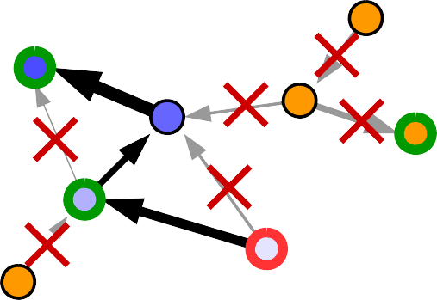
Beyond basic method
●
Adapt for directed, weighted network
active observers
Weights on links mean BFS will be according to shortest mean time, not topological distance.
They also span only part of network reachable from given node in directed networks.
Only active observers are taken.
o
0
o
o
2
1
s
passive observer
(no observation)
Mean: path lengths become sums of delays on paths
[ ]
|P |−|P |
→ μ( P )−μ( P )]
μ=μ
s 1
s 0
[
⃗
si s 0
|P |−|P |
s 2 s 0
Variance: can't use paths to/from reference because they are always from source towards observer – use source→observer paths instead; variance depends on path
]
→ σ ( P ∩P / P )+ σ² ( P /( P ∪P ))]
[
2
|P₀₂∩P₀₁|
|P₀₂|
si sj s 0 s 0 si sj

Slide 9
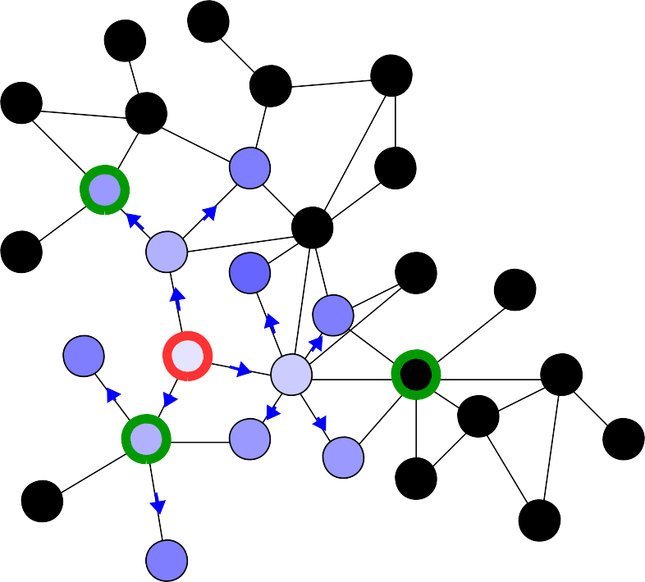
Beyond basic method
●
Early estimation of source using yet silent observers
A contagion started spreding out !
We have this situation now, we know 2 places where it already reached. Is this all information we can use to detect the source ?
t =4
2
t =?
What about the 3rd place, where it did not reach yet ?
3
t₁=3
Can we use that information to increase the chances of succesfully finding the source early on ?
2 active observers
passive observer
(no time measurement yet)
Yes, we can.

Slide 10
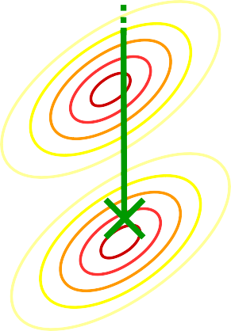
Beyond basic method
●
Early estimation of source using yet silent observers
If passive observers are not infected yet, it means that time to reach that observer is larger than largest observed time.
t =4
2
t
t >4
3
3
t₁=3
measured t
2
measured t Effectively, measurement is not a point, but a part of space
t
2
1,2
of arrival times (here, a line because we have 1 passive observer, but for more observers it's more dimensional)
Need to integrate over passive times > max time

Slide 11
Beyond basic method
●
Early estimation of source using yet silent observers
t
Possible approximations:
4
Integrate over this area
●
Independent passive observers
*|
∏
t
P(t s)= P( t |
s)
P(t_{i} >t_{max} )
max
a
i passive
●
Mutually independent passive observers
t
t
∏
max
3
*
|
P(t s)= P( t |
s)
P(t >t |t )
a
i passive
i max p
Integrating over an arbitrary cut of correlated multivariate normal distribution (gaussian orthant problem) is a hard problem – closed form analytical solutions exist only for up to 3 dimensions
●
Numerical solutions
Can be too expensive computationally

Slide 12
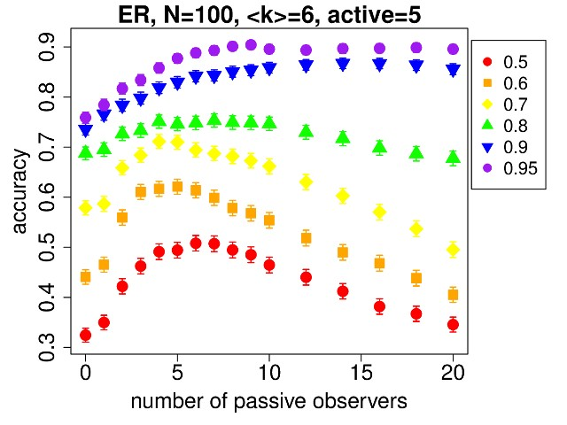
Beyond basic method
●
Early estimation of source using yet silent observers
Does it actually work ?
Why can taking too many decrease the accuracy ?
- since we assume independent, they don't take correlations into account and if they outnumber real observers, they shift “best” towards the “uncorrelated best”
- mutually independent passive observers approximation should solve that (at least partially)
Results for independent passive observers approximation show that it does, but only if we take not too many of them.

Slide 13
Beyond basic method
Other issues or extensions:
Using different spread model, where spreading is not certain (for example full SIR with recovery)
Where to put observers in a network if we want to
maximize accuracy ?
Inverse: how to design spreading method to hide the source ?
Other methods of finding source than maximum likelihood
●
●
●
●

Slide 14
Thank you
P.C. Pinto, P. Thiran, M. Vetterli, “Locating the source of diffusion in large-scale networks”, Physical Review Letters 109, 068702 (2012), doi: 10.1103/PhysRevLett.109.068702
R. Paluch, X. Lu, K. Suchecki, B.K. Szymański, J.A. Hołyst, “Fast and accurate detection of spread source in large complex networks”, Scientific Reports 8, 2508 (2018), doi: 10.1038/s41598-018-20546-3
Ł.G. Gajewski, K. Suchecki, J.A. Hołyst, “Multiple propagation paths enhance locating the source of diffusion in complex networks”, Physica A 519, 34-41 (2019), doi: 10.1016/j.physa.2018.12.012
R. Paluch, B.K. Szymański, J.A. Hołyst, “Efficient observers for source localization in complex networks: the state-of-the-art and comparative study”, Future Generation of Computer Systems, 112(11):1070-1092 June 22, 2020.
Y. Lytkin, R. Paluch, Ł. Gajewski, K. Suchecki, K. Bochenina, B.K. Szymanski, J.A. Hołyst, “How much information is in silence”, in preparation

